Slide 1
Bootcamp Overview:
Machine Learning for
Materials Science (ML4M)
Ben Afflerbach, Dane Morgan
July 19, 2023
August 16, 2023
Day 2 Activities:
Shared through the Bootcamp Google Drive Folder: https://drive.google.com/drive/folders/1TjL5o1-mwN8pRCQUyWeMmjsEr-KHvyNf?usp=sharing
Running through Google Colab
Follow instructions in the Agenda document to add the “ML4M - Bootcamp – Summer 2023” folder to your “My Drive” https://docs.google.com/document/d/1cQAASiwEHIv41tbnsuQrHGs9JxXb0W0XM2aX85VwoOI/edit?usp=sharing

Slide 2
Bootcamp Overview:
Machine Learning for
Materials Science (ML4M)
Ben Afflerbach, Dane Morgan
July 19, 2023
August 16, 2023

Slide 3
Goals:
Introduce universal concepts in materials science machine learning research
Obtain hands on experience with common Python packages
Spark interest in further skill building related to machine learning
Connect to a network of experienced machine learning researchers

Slide 4
Bootcamp Agenda
Day 1
Introduction to machine learning for materials science
Working with tabular data
Featurizing materials science data
Assessing machine learning models
Key Tools:
Scikit-learn
Pandas
Day 2
Working with image data
Introduction to image based techniques
Types of deep neural networks
Materials applications
Key Tools:
Tensorflow / Keras
Day 3
Introduction to natural language processing
How can we use Large Language Models (LLMs)
Key tools:
GPT

Slide 5
Participation Guidelines
During Meetings
Ask questions at any time! Use the raise hand feature in Zoom Or type directly in chat
The Zoom call will be recorded
Follow along with Google Colab based interactive activities
Outside of Boot camp times (optional)
Attend help-desk hours Wednesday and Thursday 9:30 – 10:30 am
For Bootcamp Links, Materials, etc. see the bootcamp google drive:
https://drive.google.com/drive/folders/1TjL5o1-mwN8pRCQUyWeMmjsEr-KHvyNf?usp=sharing

Slide 6
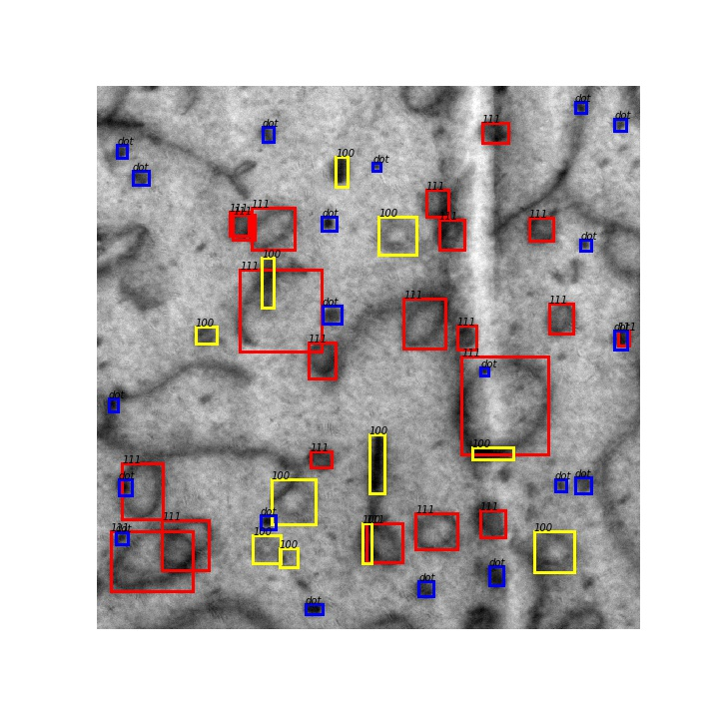


Day 2 Machine Learning for Materials Science Adapted From: Computer Vision with Deep Learning for Materials
By Dane Morgan, Ben Afflerbach, Ryan Jacobs

Slide 7

Basic Problems in Computer Vision
Classification + Localization
(Semantic/Instance) Segmentation
Classification
Object Detection
Figure credit: https://medium.com/comet-app/review-of-deep-learning-algorithms-for-object-detection-c1f3d437b852

Slide 8
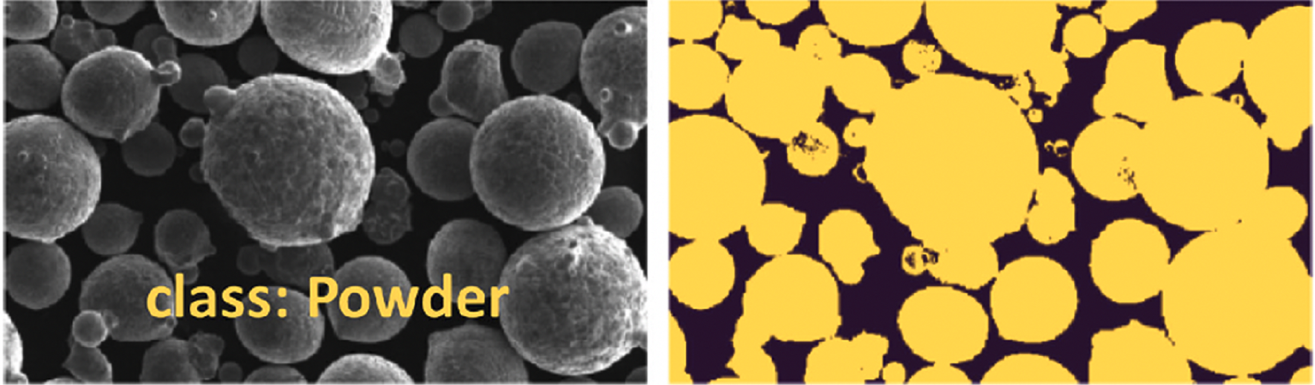
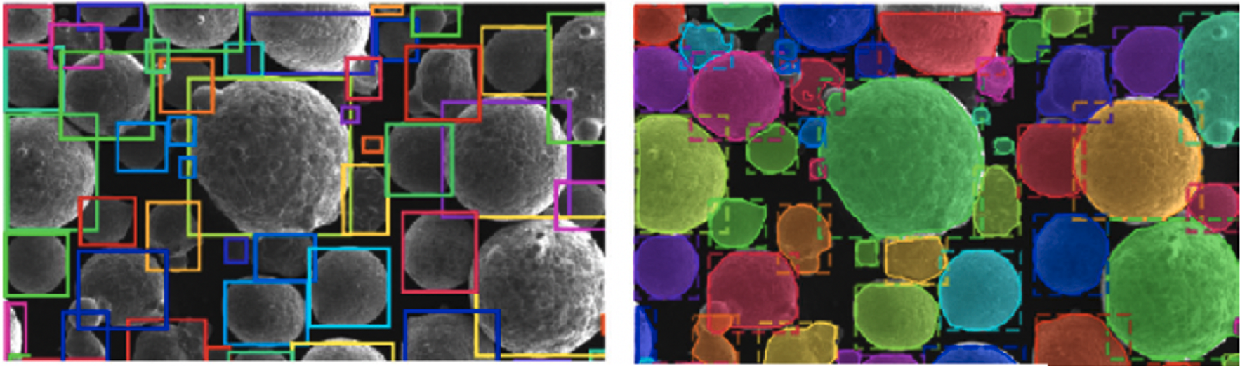
Applications of Deep Learning Computer Vision in Materials
Methods and analysis of metal powder particle SEM images
Classification (ResNet 50, VGG16)
Semantic Segmentation (U-Net)
Object detection (Faster R-CNN, YOLO)
Instance segmentation (Mask R-CNN)
Figure credit: Holm, E. et al., Metall. Mater. Trans. A 2020: https://doi.org/10.1007/s11661-020-06008-4
Notes:
Classify particles
Count and characterize them
Identify types of particles

Slide 9
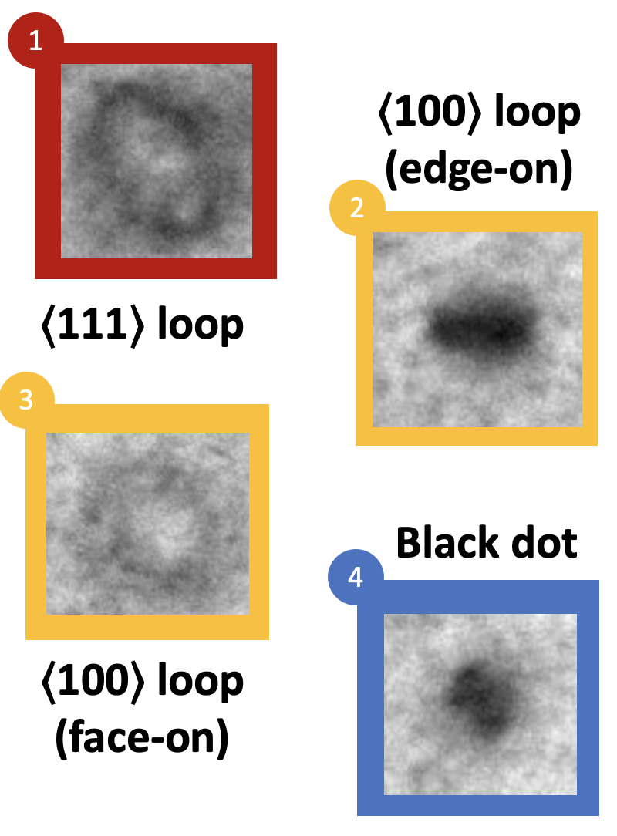
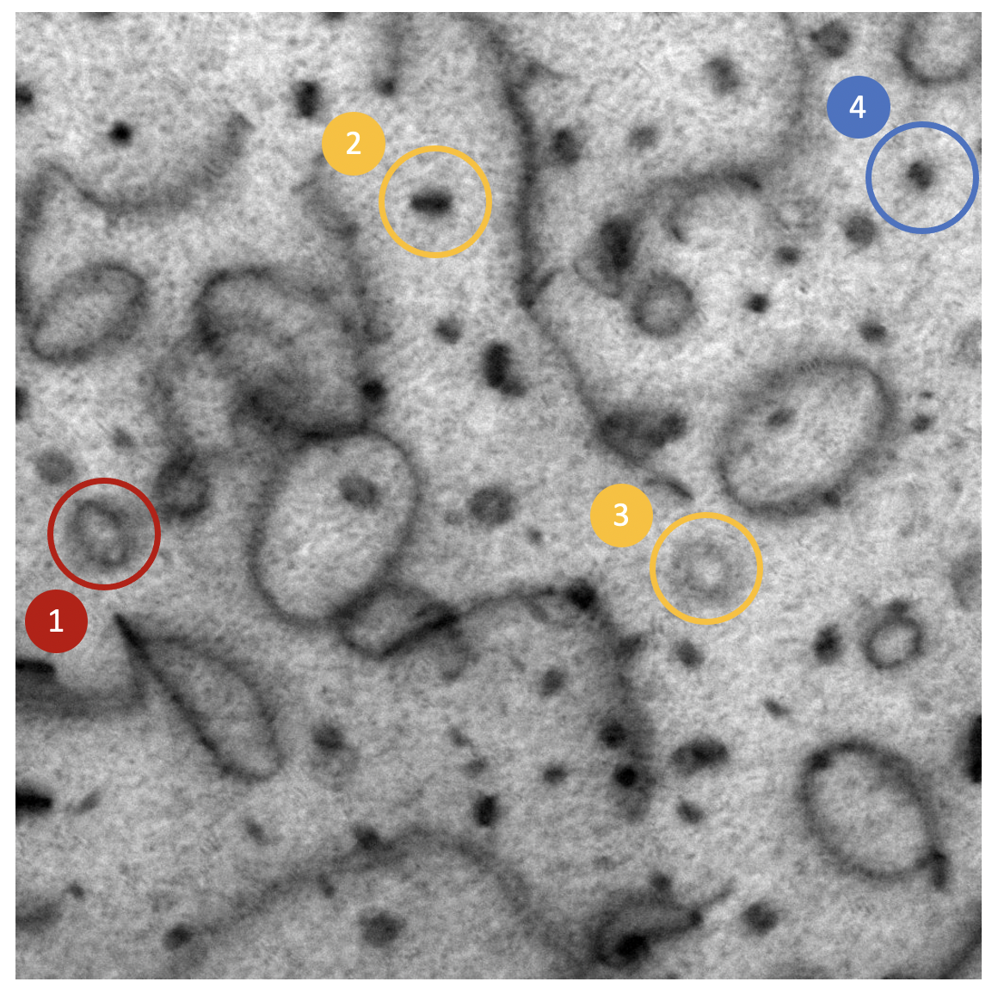
Today’s Lab: Radiation Defects in Electron Microscopy
50 nm
Jacobs, R., et al. Cell Rep. Phys. Sci. 2022: https://doi.org/10.1016/j.xcrp.2022.100876

Slide 10
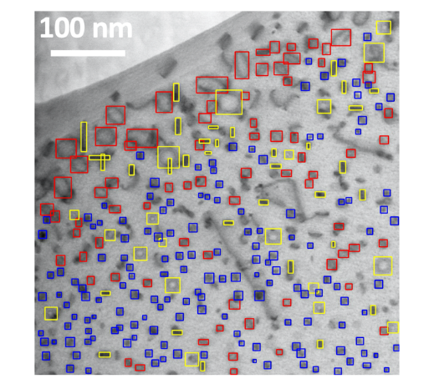
Using a Variety of Models
Classification with
Fully connected NN
Convolutional NN - Hand crafted
Convolutional NN – VGG Backbone, data augmentation.
Object detection with YOLO
Jacobs, R., et al. Cell Rep. Phys. Sci. 2022: https://doi.org/10.1016/j.xcrp.2022.100876;
Shen, et al., Comp. Mat. Sci. 2021 https://doi.org/10.1016/j.commatsci.2021.110576

Slide 11
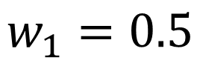
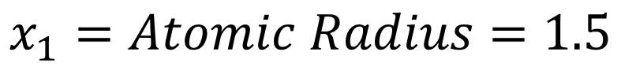
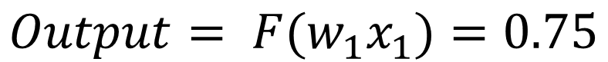
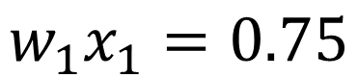
What Are Key Parts of the NN?
$$x_{1}=Atomic Radius=1.5$$
Input
Layer
$$w_{1}=0.5$$
w₁
Output
j
$$w_{1}x_{1}=0.75$$
……
$$Output= {F(w}_{1}x_{1})=0.75$$
Figure credit: Modified from Hung-yi Lee – Deep Learning Tutorial

Slide 12
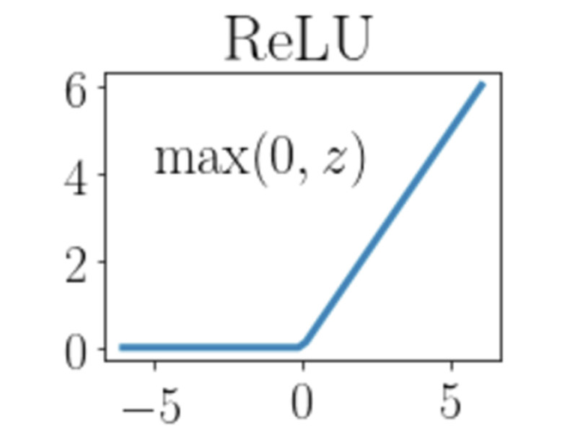
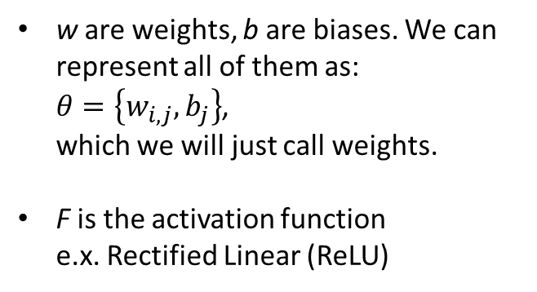
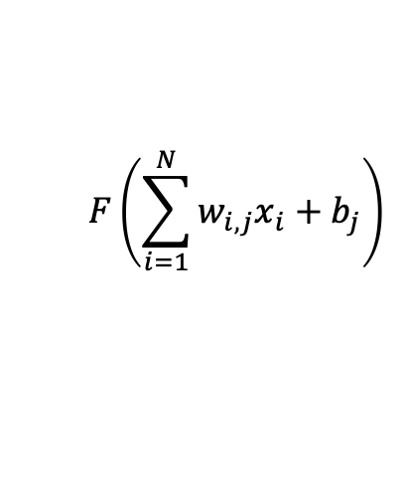
What Are Key Parts of the NN?
The NN has two major parts
Weights: Optimized during a fit to a certain NN
Hyperparameters: Relate to the type of NN (number of layers, neurons/layer, activation function, training methods, …)
w are weights, b are biases. We can represent all of them as: $θ=\left\{w_{i,j},b_{j}\right\}$, which we will just call weights.
F is the activation function e.x. Rectified Linear (ReLU)
Input
Layer
w₁
w₂
$$F\left(\sum_{i=1}^{N}{w_{i,j}x_{i}+b_{j}}\right)$$
j
……
w_{N}
Figure credit: N.S. Johnson, et al., Additive Manufacturing, 2023
Figure credit: Modified from Hung-yi Lee – Deep Learning Tutorial

Slide 13
What is Deep Learning?
Models with “many” layers (e.g., >3, although value is not precise)
Fully Connected Networks (FCN)
Input
Layer 1
Layer 2
Layer L
Output
……
y₁
……
y₂
……
……
……
……
……
……
y_{M}
Input Layer
Output Layer
Hidden Layers
Figure credit: Hung-yi Lee – Deep Learning Tutorial

Slide 14
Challenge With Featurizing Image Data
Input
Layer 1
Layer 2
Layer L
Output
……
y₁
……
y₂
……
……
……
……
……
……
y_{M}
Input Layer
Output Layer
Hidden Layers
Figure credit: Hung-yi Lee – Deep Learning Tutorial
Notes:
To use machine learning, the input must be a set of numbers, typically just a n-tuple vector. The process of turning some input into a set of numbers is called featurizing.
The simplest and most direct way to featurize an image is just to consider the matrix of intensities and flatten it into a vector. But we can effectively do much better with Convolutional Neural Networks (CNNs).
Shade in boxes

Slide 15
Challenge With Featurizing Image Data
How about we just flatten into one long vector?
1
1
2
2
1
1
2
2
(1,1,2,2,1,1,2,2,3,3,4,4,3,3,4,4)
3
3
4
4
3
3
3
3
4x4 Image
Notes:
To use machine learning, the input must be a set of numbers, typically just a n-tuple vector. The process of turning some input into a set of numbers is called featurizing.
The simplest and most direct way to featurize an image is just to consider the matrix of intensities and flatten it into a vector. But we can effectively do much better with Convolutional Neural Networks (CNNs).
Think about modifying to just be no weighting for nearby pixels.

Slide 16
Challenge With Featurizing Image Data
[1122112233443344]
Input
Layer 1
Layer 2
Layer L
Output
……
y₁
Each neuron is connected all of the input pixels
Weights modify which pixels strongly activate that neuron
……
y₂
……
……
……
……
……
……
y_{M}
Input Layer
Output Layer
Hidden Layers
Figure credit: Hung-yi Lee – Deep Learning Tutorial
Notes:
To use machine learning, the input must be a set of numbers, typically just a n-tuple vector. The process of turning some input into a set of numbers is called featurizing.
The simplest and most direct way to featurize an image is just to consider the matrix of intensities and flatten it into a vector. But we can effectively do much better with Convolutional Neural Networks (CNNs).
Think about modifying to just be no weighting for nearby pixels.

Slide 17
Challenge With Fully Connected NNs for Images
Input
Layer 1
Layer 2
Layer L
Output
……
y₁
……
y₂
……
……
……
……
……
……
y_{M}
256x256x(3 colors)
N =196,608 ~ 2x10⁵
10⁵ nodes per layer
10⁵ * 10⁵
= 10¹⁰ weights added per layer!
Notes:
A typical image might have 256x256x(3 colors) = 196608 ~ 2x10⁵ input (or input layer) intensities. If we treat that as a flat vector and feed it into any comparable # of nodes (e.g., 2x10⁵⁾ with a fully connected layer, we have 2x10⁵ * 2x10⁵ = 4x10¹⁰ weights. And this is just the first layer! Convolutional Neural Networks help fix this problem!
Note there would also be 2x10^5 biases but these are very small compared to the number of weights.
Just this 2 layers is the same order of magnitude complexity as ChatGPT

Slide 18

What is a Convolution in CNNs? (In Pictures)
Layer 2
Layer 1
Figure credit: https://towardsdatascience.com/types-of-convolutions-in-deep-learning-717013397f4d

Slide 19

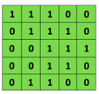
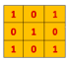
What is a Convolution in CNNs? (In Pictures)
Output from layer N
Output from layer N
Combine these as follows
Input to layer N+1
Convolutional
3x3 filter
Input matrix
Only 9 weights per layer!
Figure credit: http://deeplearning.stanford.edu/wiki/index.php/Feature_extraction_using_convolution

Slide 20
Subsampling (Pooling) in CNNs? (In Pictures)
MaxPool with a 2×2 filter with stride of 2
1 | 3 | 5 | 3
4 | 2 | 3 | 1
3 | 1 | 1 | 3
0 | 1 | 0 | 4
4 | 5
3 | 4
Input Matrix
Output Matrix
The Pooling just gives a new set of numbers which can then be used as input to a convolution, flattened, or something else, but is not input into an activation function
Notes:
Dane – Figure reference???

Slide 21
A Simple CNN
Cat. 1
Cat. 2
. . .
. . .
. . .
Input 32x32x1
Convolution 3x3, stride 1 29x29x3
Max Pool
2x2, stride 2 14x14x3
Flatten
588x1
Fully connected
588x1
Figure modified from: https://www.v7labs.com/blog/convolutional-neural-networks-guide
Notes:
- Only call attention to things that happen alter in the notebook

Slide 22
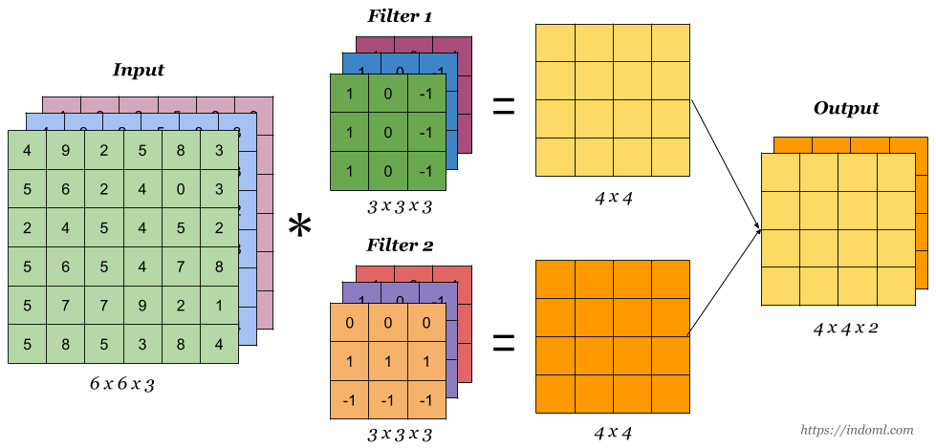
Understanding What CNN Parts “Do”
Each filter in a convolution layer picks out different “features”, e.g., edges, circles, dog nose containing, etc.
Each convolution layer picks out features at a coarser grained level since it has aggregated more space in the original image.
Figure credit: https://indoml.com/2018/03/07/student-notes-convolutional-neural-networks-cnn-introduction/
Notes:
Each pooling removes sensitivity to small shifts in location and keeps just most essential local response.

Slide 23
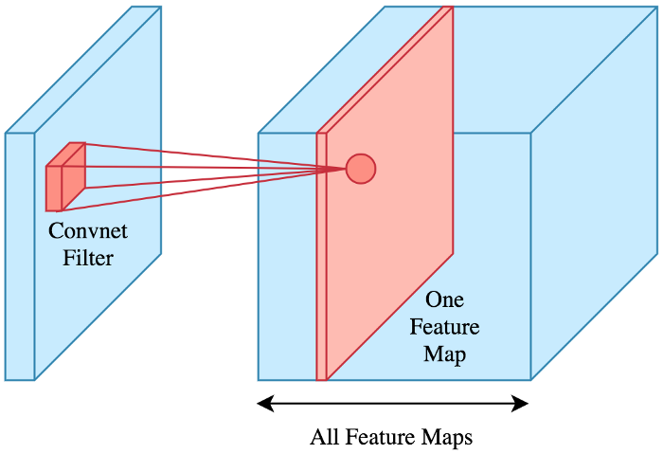
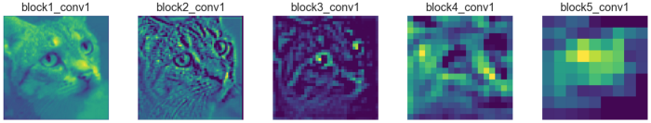
What do the Feature Maps Look Like?
Taking one feature map per layer
https://towardsdatascience.com/applied-deep-learning-part-4-convolutional-neural-networks-584bc134c1e2
Notes:
Switch order to show this first

Slide 24

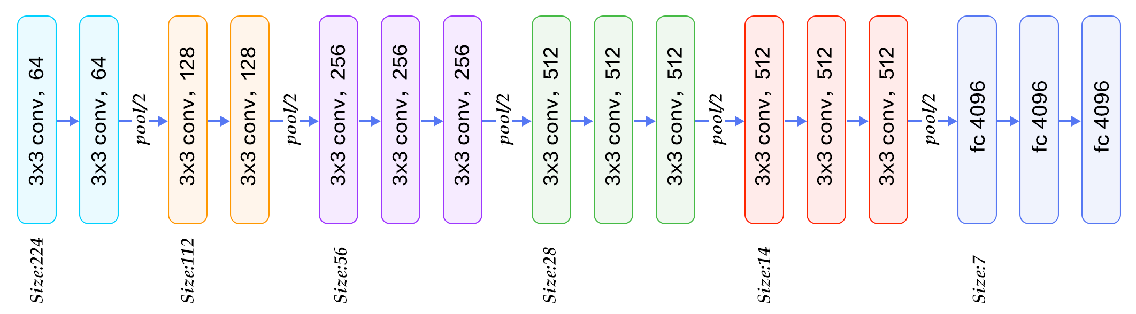
A Real CNN – VGG 16
Commonly used itself and as part of other architectures with transfer learning (a backbone in many object detection models, used in the lab for classification)
2x2 Max Pool, Stride 1
64 3x3x3 Filters, Stride 1
This is shorthand – only the first two dimensions of the conv are given, other is assumed. I write a few true dimensions for the convs below.
Figure credit: https://www.kaggle.com/code/blurredmachine/vggnet-16-architecture-a-complete-guide/notebook
Notes:
Note that 7x7x512 is the flattened vector (not shown) and mapped to 4096 node fully connected NN.

Slide 25
Summary
Classification + Localization
Object Detection
(Semantic/Instance) Segmentation
Classification
Convolutional neural networks (CNNs) are a kind of deep NN that make use of local structure in images to greatly reduce the number of necessary parameters.
CNNs can be used to accurately categorize, detect objects, and segment (find all pixels in an object), particularly when using transfer learning on pretrained networks.
State of the art tools (e.g., Yolo v8) are free and available, can be implemented with a few dozen lines of codes, and can be trained for many practical problems in a matter of hours with a single GPU.
Notes:
Think about adding in backpropogation at a high level and - “training” what is it
- high level scale and timeframe to expect
Definitely need max pooling to explain the “collapse”
Dictch historic thing and just talk in concept of weight and local weights
Maybe state of the art slide for how to we add back in useful information since we threw out a logt

Slide 26
Wrap-Up Day 2:
Machine Learning for
Materials Science
Attend the help-desk sessions if you’d like to discuss anything or ask more detailed questions!
Tomorrow Morning: 9:30 – 10:30 am
https://docs.google.com/document/d/1cQAASiwEHIv41tbnsuQrHGs9JxXb0W0XM2aX85VwoOI/edit?usp=sharing
Please fill out the quick daily feedback poll to let us know how things went for you
https://forms.gle/X3JU52CJUBASADba6
Thank you!
Notes:
add notes
URL: https://forms.gle/X3JU52CJUBASADba6

Slide 27
BACKUP

Slide 28
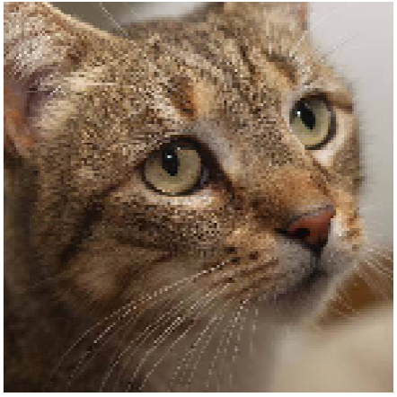
Understanding What CNN Parts “Do”
The following visualizes feature maps (also called activation maps) and filters.
Feature maps are the result of the output of a convolution and the activation function and just mapping values to intensities gives a picture.
Filters are the convolutions and typically just 3x3 or 5x5 matrices. So, we visualize the image to which the filter has a maximal response, i.e., what the filter finds most readily.
All the results shown on this topic are taken from this link, which also has code to do this kind of analysis yourself. https://towardsdatascience.com/applied-deep-learning-part-4-convolutional-neural-networks-584bc134c1e2
VGG 16 (trained on ImageNet I think)
Block 1
Block 2
Block 3
Block 4
Block 5

Slide 29
Comparing Neural Network to Decision Tree
Decision Tree
Neural Network
Root
Hidden Layer Neuron
Input Neuron
Output Neuron
Leaf
Decision
Hidden Layer Neuron
Input Neuron
Hidden Layer Neuron
Output Neuron
Decision
Leaf
Input Neuron
Hidden Layer Neuron
Input Layer
Hidden Layer
Output Layer
Leaf
Leaf
Training is changing the strength of connections in the network
Predicting is putting a signal through the whole network and seeing which output neuron/s light up
Training is building structure of the tree
Predicting is choosing a single path to a single leaf node
Notes:
Grab specific example version

Slide 30
Outline
What are deep neural networks (NNs)?
Training and predicting with deep NNs
Convolution Neural Networks (CNNs)
Image Classification with CNNs
Object Detection with CNNs
Materials Applications and Lab Introduction

Slide 31
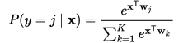
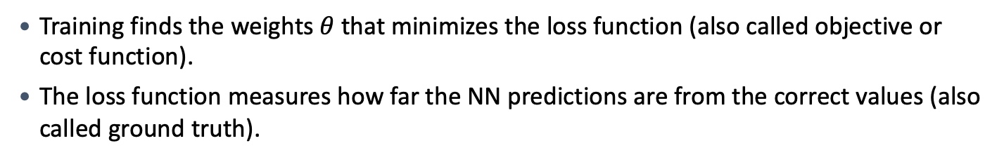
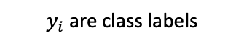
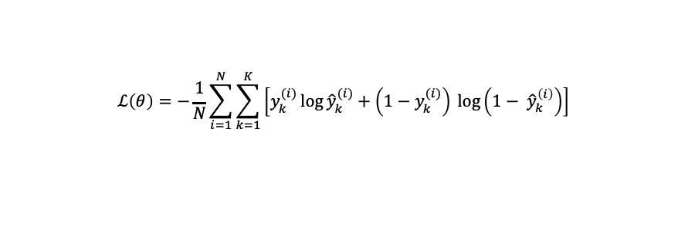

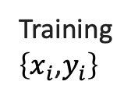
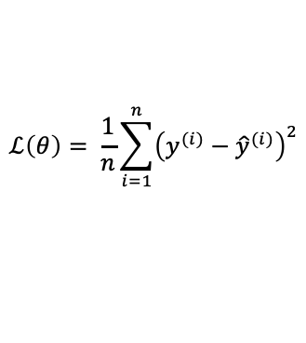
Training NNs and Loss Functions
Training finds the weights$θ$ that minimizes the loss function (also called objective or cost function).
The loss function measures how far the NN predictions are from the correct values (also called ground truth).
Classification
Regression
Training
$\left\{x_{i}\text{,}y_{i}\right\}$
$y_{i}$ are class labels
$y_{i}$ are values
Softmax Activation (gives probability distribution)
Linear (Identity) or Sigmoid Activation
Output
Layer
Cross-entropy
Mean Squared Error
Loss function
$$ℒ\left(θ\right)=−\frac{1}{N}\sum_{i=1}^{N}{\sum_{k=1}^{K}{\left[y_{k}^{(i)}\log{{\hat{y}}_{k}^{(i)}+\left(1−y_{k}^{(i)}\right) }\log\left(1− {\hat{y}}_{k}^{\left(i\right)}\right)\right]}}$$
$$ℒ\left(θ\right)= \frac{1}{n}\sum_{i=1}^{n}{{\left(y^{(i)}−{\hat{y}}^{(i)}\right)}^{2}}$$
Image credit: Ismini Lourentzou – Introduction to Deep Learning
model predicted labels are ${\hat{y}}_{i}$
Notes:
https://developers.google.com/machine-learning/crash-course/multi-class-neural-networks/softmax

Slide 32
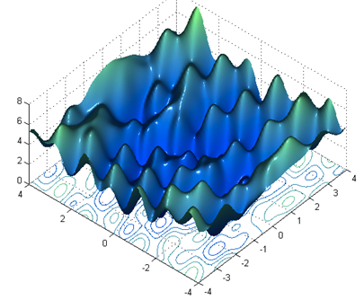
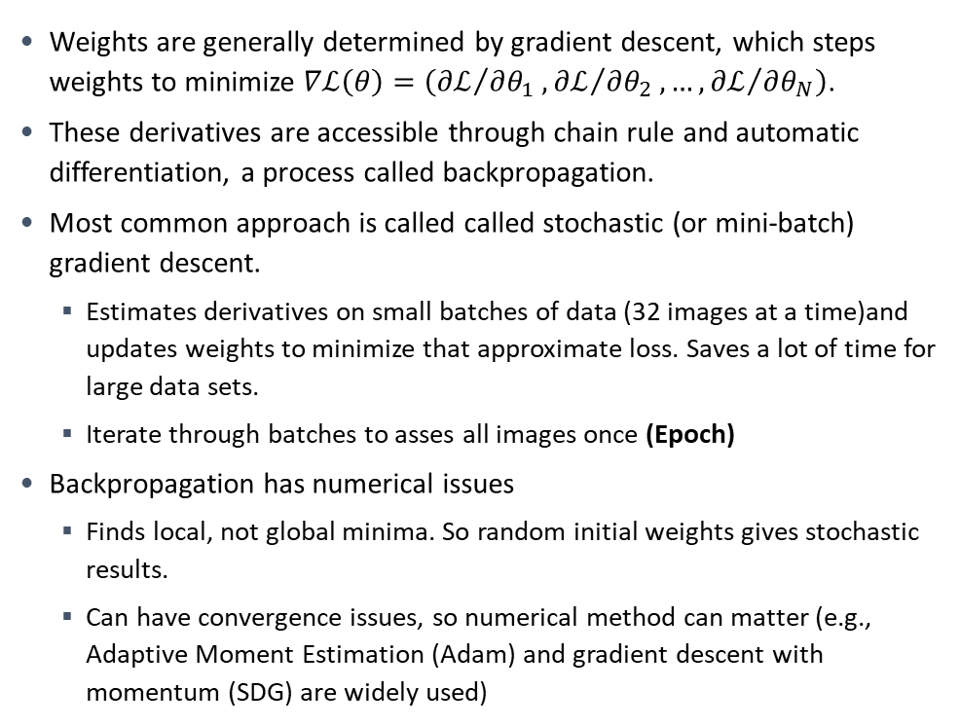
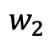
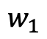
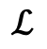
Training NNs and Backpropagation
Weights are generally determined by gradient descent, which steps weights to minimize $∇ℒ\left(θ\right)=\left({∂ℒ}/{∂θ_{1}},{∂ℒ}/{∂θ_{2}},…,{∂ℒ}/{∂θ_{N}}\right)$.
These derivatives are accessible through chain rule and automatic differentiation, a process called backpropagation.
Most common approach is called called stochastic (or mini-batch) gradient descent.
Estimates derivatives on small batches of data (32 images at a time)and updates weights to minimize that approximate loss. Saves a lot of time for large data sets.
Iterate through batches to asses all images once (Epoch)
Backpropagation has numerical issues
Finds local, not global minima. So random initial weights gives stochastic results.
Can have convergence issues, so numerical method can matter (e.g., Adaptive Moment Estimation (Adam) and gradient descent with momentum (SDG) are widely used)
$$ℒ$$
$$w_{1}$$
$$w_{2}$$
Figure credit: Hung-yi Lee – Deep Learning Tutorial
Notes:
https://developers.google.com/machine-learning/crash-course/multi-class-neural-networks/softmax

Slide 33
Training NNs and Avoiding Overfitting
Test
Train, Validation, Test split (Typically 80%/10%/10%)
Training data: Loss is optimized on this data by backpropagation.
Validation data: Model is assessed on this data every training epoch, potentially updating model hyperparameters using values.
Test data: Model is assessed on this data at the end of training to assess likely performance. Often skipped.
Early Stopping
Stop early to avoid overfitting.
Set stop point when the loss has not reduced after n epochs (n is called patience).
Loss
Validation
Train
Epochs
Early stop
Test
Loss
Validation
Train
Epochs

Slide 34
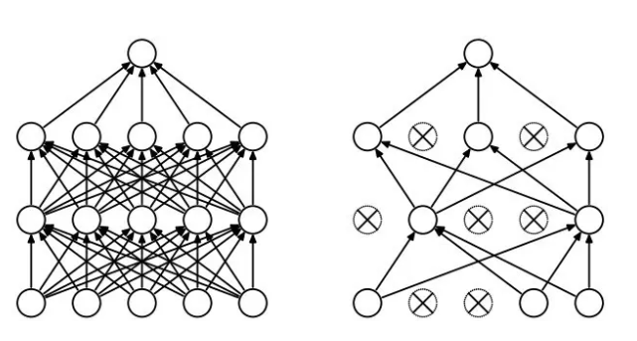
Training NNs and Avoiding Overfitting
Dropout
Randomly drop out units and their connections during training, changing each epoch.
Introduces a hyperparameter dropout rate (p), which is fraction of time a node is dropped. Typically p~0.2.
FIgure credit: Hung-yi Lee – Deep Learning Tutorial

Slide 35
Predicting with Deep NNs
Applying weights to input features and adding a bias is basically a matrix multiplying a vector.
Then some additional modest cost for activation functions (greatly reduced if you use ReLU, since that is linear) and other stuff one might add (e.g., convolution, which is also matrix multiplying vectors).
Matrix multiplying a vector is very fast and highly optimized. So once trained, deep learning NNs are generally quite fast, although this depends on your needs and compute power.
For most materials problems the trained network is quite fast enough. Some exceptions (that I know about) are
When computing needs to be done on an “edge” device (e.g., a phone) – not sure this ever happens in MS&E …
When prediction needs to be done in real time (e.g., analyzing TEM data on a microscope, see Theia Scientific)
When predicting needs to be very fast (e.g., <<1s) – Machine learned interatomic potentials for molecular dynamics (~10¹⁰ evaluations in many simulations).
Notes:
10^-8 s MD x 10^3 atoms x 1/10^-15 1/s timestep = 10^10 potential evaluations of E and F on an atom.

Slide 36
Outline
What are deep neural networks (NNs)?
Training and predicting with deep NNs
Convolution Neural Networks (CNNs)
Image Classification with CNNs
Object Detection with CNNs
Materials Applications and Lab Introduction
Some useful links:
https://adeshpande3.github.io/A-Beginner%27s-Guide-To-Understanding-Convolutional-Neural-Networks/
https://indoml.com/2018/03/07/student-notes-convolutional-neural-networks-cnn-introduction/
https://towardsdatascience.com/applied-deep-learning-part-4-convolutional-neural-networks-584bc134c1e2

Slide 37
A Few Basic Goals Behind CNNs
Reduce the number of parameters
Connect nearby neurons
Create hierarchical information
The CNN is enabled with two major tricks – Convolutions and subsampling (typically pooling).
Notes:
Reduce the number of parameters you need in fully connected neural networks by avoiding fully connected architecture and keeping number of neurons needed in a layer manageable.
Connect nearby neurons to each other to allow local information to be prioritized first and to minimize number of connections.
Create hierarchical information by aggregating local information into large clumps to allow global information to be captured as well.
Make the results equivariant with translation (and slightly invariant due to pooling), meaning that translating input pixels will translate output response (f(x) is equivariant to g(x) if f(g(x)) = g(f(x))). This reduces number of parameters.
We organize node layers as matrices (approximately tracking the pixels in an image), or more accurately, multiple matrices (i.e., volumes of nodes) until the very end of the CNN.

Slide 38
What is a Convolution in CNNs? (In Words)
It is a matrix that multiplies an input set of values in a matrix (e.g., neuron outputs) to get a new value.
The matrix is local (connects a few output from layer N to inputs to layer N+1) and it gets applied repeatedly while “striding” (taking steps in columns and rows) across the input matrix (this is convolution) to create an output matrix of values.
This maps output of PxP nodes to input for QxQ nodes where Q is less than P due to stride and edge effects. You can “stride” with bigger steps to output to make Q smaller.
This matrix connects output from one NN layer of activation function output to input for another set of NN activation functions, so it is basically just a normal set of weights like in a normal NN. But it is not fully connecting, just locally connecting.
The convolution is a map from a matrix to another matrix of somewhat smaller size. If you think of these matrices as intensities, this just maps pictures to somewhat smaller pictures.
https://towardsdatascience.com/types-of-convolutions-in-deep-learning-717013397f4d

Slide 39
Today’s Lab: Radiation Defects in Electron Microscopy
How We Can Use Machine Learning to Analyze Images Like Below
50 nm
Jacobs, R., et al. Cell Rep. Phys. Sci. 2022: https://doi.org/10.1016/j.xcrp.2022.100876

Slide 40
We Can Use Multiple Matrices and Convolutions
Figure credit: https://indoml.com/2018/03/07/student-notes-convolutional-neural-networks-cnn-introduction/
If a layer has multiple matrices (e.g., RGB, multiple earlier filters), we use one convolution for each input matrix and then add all their contributions from across all the convolutions together to produce one output matrix. One such set of convolutions is called a filter and produces one output matrix.
So 6x6x3 input will be mapped by one 3x3x3 convolution filter onto a single 4x4x1 matrix.
We can (and usually do) use multiple convolution filters to make a new layer! If I use two 3x3x3 convolutions I can take a 6x6x3 input to a 4x4x2 output. Multiple convolutions give more ways to learn.
Notes:
3 layers might R G B or might be from multiple filters in a previous layer.

Slide 41
What is Subsampling (Pooling) in CNNs? (In Words)
Subsampling is a function that takes a small region of an input matrix and returns a single values.
Subsampling gets applied repeatedly while “striding” (taking steps in columns and rows) across the input matrix (like a convolution) to create an output matrix of values.
Greatly reduces the number of values from input to output, which reduces the nodes needed in the next layer of the CNN.
Subsampling is a map from a matrix to another matrix of significantly smaller size. If you think of these matrices as intensities this just maps pictures to smaller pictures.
Maxpool is most common subsampling.

Slide 42
What is Subsampling (Pooling) in CNNs? (In Pictures)
1 | 3 | 5 | 3
4 | 2 | 3 | 1
3 | 1 | 1 | 3
0 | 1 | 0 | 4
MaxPool with a 2×2 filter with stride of 2
4 | 5
3 | 4
Output Matrix
Input Matrix
Input to next step
Warning!!! Now each square is a number but NOT input to a node activation function.
Output from layer N
Each square represents a neuron and its output.
The Pooling just gives a new set of numbers which can then be used as input to a convolution, flattened, or something else, but is not input into an activation function..
Notes:
Dane – Figure reference???

Slide 43
Introduction to CNN Notation
Input is 32x32x1 volume of data
3 3x3 filters, stride 1, produce 29x29x3 volume of data
Data fed into 29x29x3 set of NN nodes
Output is 29x29x3 volume of data
2x2 Max Pool, stride 2, produces 14x14x3 volume of data
. . .
Input Data
Nodes
Output Data
Output Data
Collapse input, nodes, output to one picture for simplicity
Input is 32x32x1 volume of data
2x2 Max Pool, stride 2, produces 14x14x3 volume of data
Convolution, stride 1, 29x29x3
. . .
Input Data
Output Data

Slide 44
A Simple CNN
We talk about volumes in each layer, which generally refer to values of intensities (input layer) or nodes/input values/output values (layers).
Each layer is connected by convolutions or subsampling (until the end).
We typically apply multiple convolutions from a given layer to generate may more 2D slices of nodes in the next layer. This picture uses 3 convolutions from the input to the Layer 1.
At the last step we “flatten” the volume to make a single vector and then pass it through a fully connected traditional NN for classification or regression.
Cat. 1
Cat. 2
. . .
. . .
. . .
Input 32x32x1
Convolution 3x3, stride 1 29x29x3
Max Pool
2x2, stride 2 14x14x3
Flatten
588x1
Fully connected
588x1
Figure modified from: https://www.v7labs.com/blog/convolutional-neural-networks-guide

Slide 45
A Real CNN – VGG (Near top ImageNet ILSVRC-2014)
Commonly used itself and as part of other architectures with transfer learning (a backbone in many object detection models, used in the lab for classification)
2x2 Max Pool, Stride 1
64 3x3x3 Filters, Stride 1
This is shorthand – only the first two dimensions of the conv are given, other is assumed. I write a few true dimensions for the convs below.
Figure credit: https://www.kaggle.com/code/blurredmachine/vggnet-16-architecture-a-complete-guide/notebook
Notes:
Note that 7x7x512 is the flattened vector (not shown) and mapped to 4096 node fully connected NN.

Slide 46
Understanding What CNN Parts “Do”
Each filter in a given convolution layer picks out different “features”, e.g., edges, circles, dog nose containing, etc.
Each convolution layer picks out features at a coarser grained level since it has aggregated more space in the original image.
Each pooling removes sensitivity to small shifts in location and keeps just most essential local response.
Figure credit: https://indoml.com/2018/03/07/student-notes-convolutional-neural-networks-cnn-introduction/

Slide 47
Understanding What CNN Parts “Do”
The following visualizes feature maps (also called activation maps) and filters.
Feature maps are the result of the output of a convolution and the activation function and just mapping values to intensities gives a picture.
Filters are the convolutions and typically just 3x3 or 5x5 matrices. So, we visualize the image to which the filter has a maximal response, i.e., what the filter finds most readily.
All the results shown on this topic are taken from this link, which also has code to do this kind of analysis yourself. https://towardsdatascience.com/applied-deep-learning-part-4-convolutional-neural-networks-584bc134c1e2
VGG 16 (trained on ImageNet I think)
Block 1
Block 2
Block 3
Block 4
Block 5

Slide 48
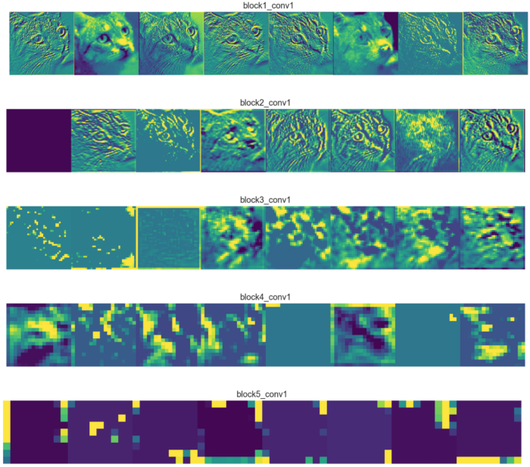
What do the Feature Maps Look Like?
https://towardsdatascience.com/applied-deep-learning-part-4-convolutional-neural-networks-584bc134c1e2

Slide 49
What do the Feature Maps Look Like?
https://towardsdatascience.com/applied-deep-learning-part-4-convolutional-neural-networks-584bc134c1e2
Taking one feature map per layer
The first layer feature maps (block1_conv1) retain most of the information present in the image. In CNN architectures the first layers usually act as edge detectors.
As we go deeper into the network, the feature maps look less like the original image and more like an abstract representation of it. Deeper feature maps encode high level concepts like “cat nose” or “dog ear” while lower level feature maps detect simple edges and shapes. That’s why deeper feature maps contain less information about the image and more about the class of the image.
Feature maps become sparser as we go deeper, meaning the filters detect less features. It makes sense because the filters in the first layers detect simple shapes, and every image contains those. But as we go deeper we start looking for more complex stuff like “dog tail” and they don’t appear in every image.
Notes:
Switch order to show this first

Slide 50
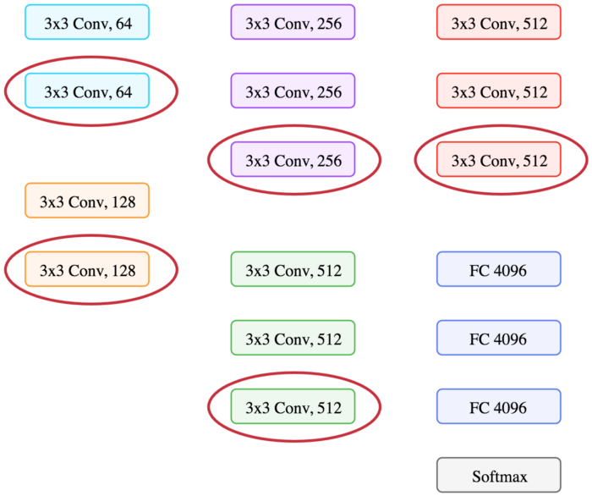
What do the Filters Look Like?
https://towardsdatascience.com/applied-deep-learning-part-4-convolutional-neural-networks-584bc134c1e2
Visualize 8 filters from each layer circled.
Filters are the convolutions and typically just 3x3 or 5x5 matrices. So, we visualize the image to which the filter has a maximal response, i.e., what the filter finds most readily.

Slide 51
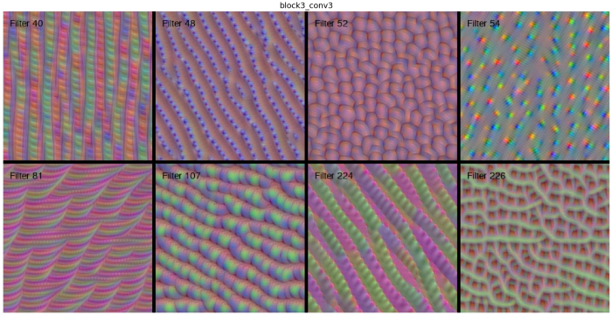
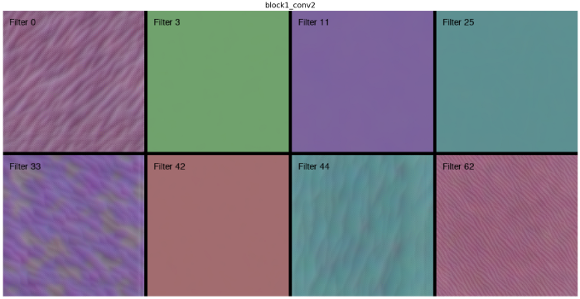
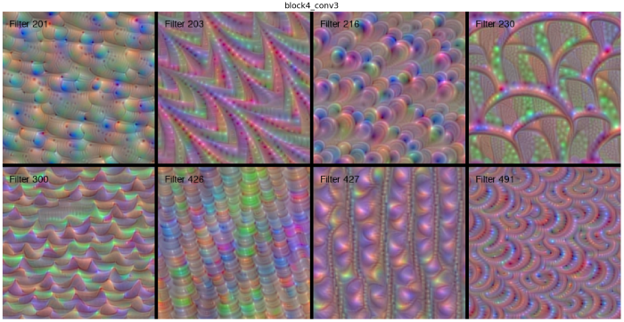
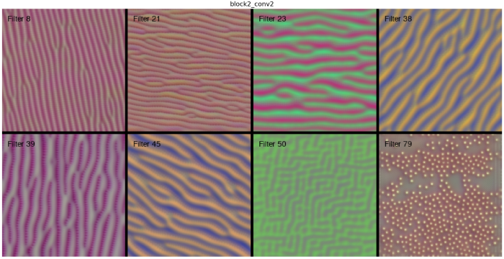
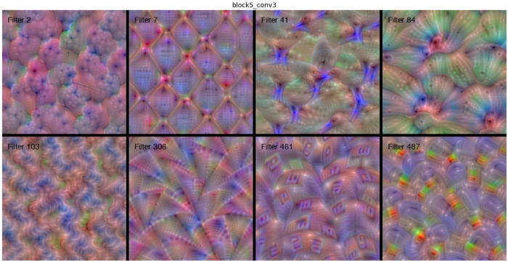
What do the Filters Look Like?
https://towardsdatascience.com/applied-deep-learning-part-4-convolutional-neural-networks-584bc134c1e2

Slide 52
What do the Filters Look Like?
https://towardsdatascience.com/applied-deep-learning-part-4-convolutional-neural-networks-584bc134c1e2
Low level are basic colors and edges.
High level is sort of like a hallucination – right filter is likely helping to detect birds in the training data! Note that it has many orientations to allow it to react to birds in many orientations.
Block 1, Conv 2, Filter 0
Block 5, Conv 3, Filter 41

Slide 53
CNN Hyperparameters
How many convolution layers and convolution + subsampling layers.
Strides and size of convolutions.
There are also many types of convolutions (e.g., see https://ikhlestov.github.io/pages/machine-learning/convolutions-types/ )
Strides and size of subsamplings.
There are also many types of subsamplings (max pooling, average pooling, etc.)
Padding of images to control edge effects.
Number and sizes (in nodes) of final connected layers.
The above help but can only be optimized so far. Most important for more than incremental (but significant) progress is creative ways of connecting layers (this can add a lot of new architectures with much better performance and new functionality).
Huge space means it is very hard to guess what will work.

Slide 54
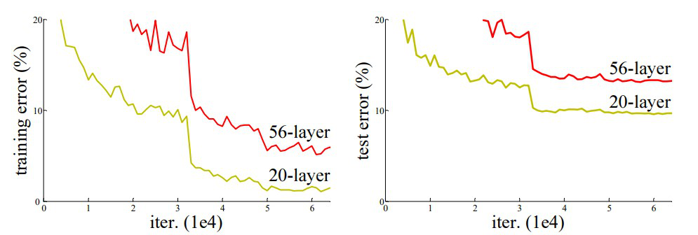
Beyond Basic CNNs – Can’t Just Add More Layers
Why not just make deeper and deeper CNNs to get better accuracy? Get numerical instabilities in the gradients that guide training and they get too large or go to zero. Reduced accuracy of deeper NN was caused by this vanishing/exploding gradient problem.
Figure credit: https://www.geeksforgeeks.org/residual-networks-resnet-deep-learning/

Slide 55
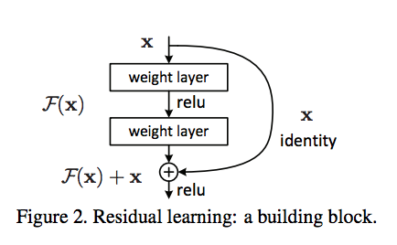
Beyond Basic CNNs – New Architectures (Residual Network = ResNet)
The basic idea is the skip connection which gives later layers access to the vector in earlier layers. So, if a couple of layers that give F(x) produce a gradient of 0, then the model effectively skips them in updating weights. So model ignores useless layers.
Figure credit: https://towardsdatascience.com/introduction-to-resnets-c0a830a288a4
https://www.geeksforgeeks.org/residual-networks-resnet-deep-learning/

Slide 56
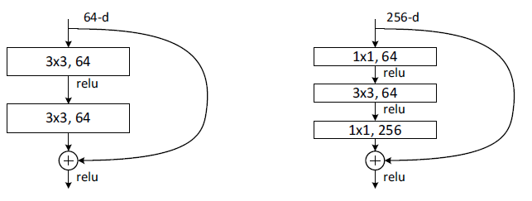
Beyond Basic CNNs – New Architectures (Residual Network = ResNet)
Then they tweak the skip idea again to make bottleneck design which uses 1x1 convolutions to reduce complexity with little loss of accuracy.
Standard residual skip
“Bottleneck” design
Figure credit; https://towardsdatascience.com/review-resnet-winner-of-ilsvrc-2015-image-classification-localization-detection-e39402bfa5d8
https://www.geeksforgeeks.org/residual-networks-resnet-deep-learning/

Slide 57
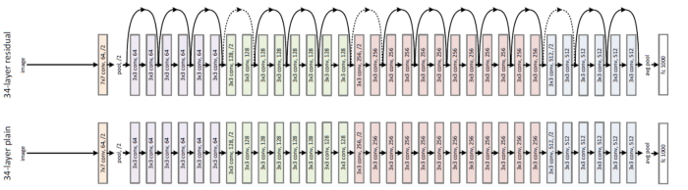
Beyond Basic CNNs – New Architectures (ResNet)
Ensemble of ResNets won ILSVRC-2014. Below is a ResNet of 50 layers, or ResNet-50 (invokes a Bottleneck design). Standard ResNets that are fit and widely used in transfer learning are ResNet-50, ResNet-101, ResNet-152.
Figure credit: https://www.geeksforgeeks.org/residual-networks-resnet-deep-learning/

Slide 58
Outline
What are deep neural networks (NNs)?
Training and predicting with deep NNs
Convolution Neural Networks (CNNs)
Image Classification with CNNs
Object Detection with CNNs
Materials Applications and Lab Introduction

Slide 59
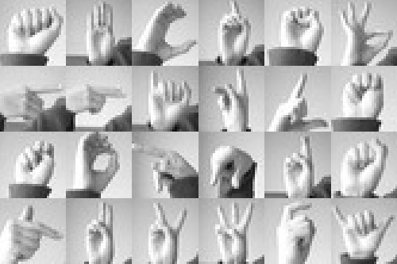
So How Do I Classify Images with a CNN?
Assume you have images from American Sign Language (ASL) and you want to classify them by letters. So your data looks likes below (this is the ASL Sign Language “MNIST” Data Set, widely available for free)
A
B
C
…
Provides 24 categories (2 signs are dynamic and not included).
All the data is labeled, each image with a category from 1 to 24 corresponding to a letter.
Figure credit: https://www.kaggle.com/code/asiyebayraktar/cnn-sign-language-mnist

Slide 60
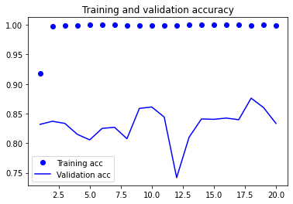
So How Do I Classify Images with a CNN?
Set up the simplest CNN, e.g., with 1 block of convolutions and pooling, then 2 layers of fully connected networks.
The final layer will have 24 nodes, one for each letter, and have a softmax activation function which gives a probability for each category.
Split data into train and validation and train the network until loss on validation is minimum.
Calculate metric of success, e.g., accuracy = fraction of predictions that are correct.
This takes about 15 lines of python code and 50s seconds of computing on CoLab with ~30k data points of 28x28 pixel images!
Accuracy is already about 87%!
Accuracy
Epoch
The NN is defined in Keras/Tensorflow as below
model = Sequential()
model.add(Conv2D(75, (3, 3), strides=1, padding="same", activation="relu",
input_shape=(28, 28, 1)))
model.add(BatchNormalization())
model.add(MaxPool2D((2, 2), strides=2, padding="same"))
model.add(Flatten())
model.add(Dense(units=512, activation="relu"))
model.add(Dense(units=num_classes, activation="softmax"))

Slide 61
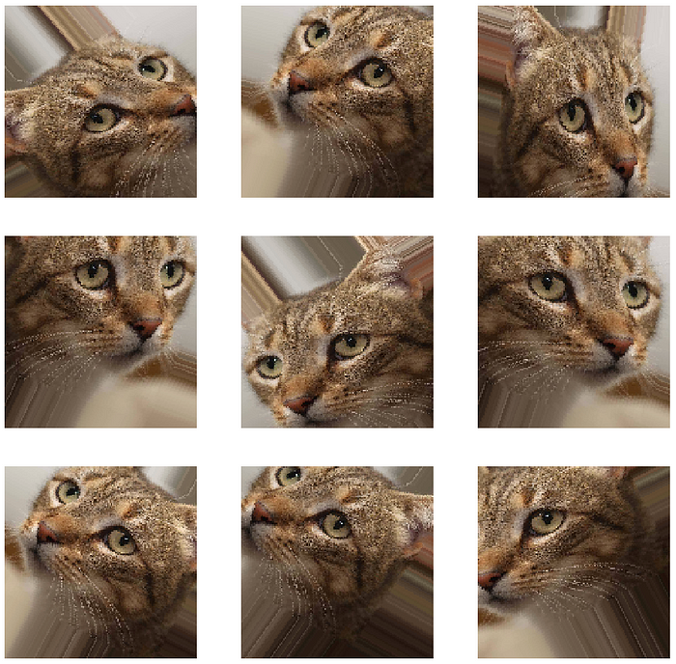
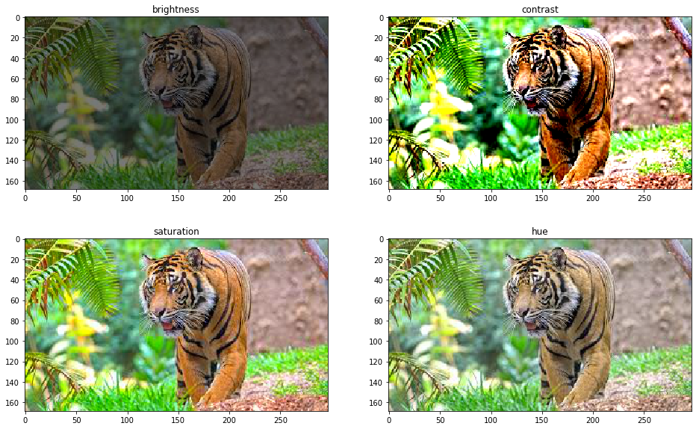
Additional Training Tricks for CNNs: Image Augmentation
Having a good set of labeled images for training takes time and one wants to make the most of them.
Many transformations of an image can be done to give new labeled examples that cover additional relevant conditions (e.g., rotation, flip, shift, stretch, brightness, saturation, …) .
These can be case specific as they should not change the image category or represent conditions that are not relevant which might confuse the model.
Figure credit: https://towardsdatascience.com/applied-deep-learning-part-4-convolutional-neural-networks-584bc134c1e2
Figure credit: https://www.v7labs.com/blog/data-augmentation-guide

Slide 62
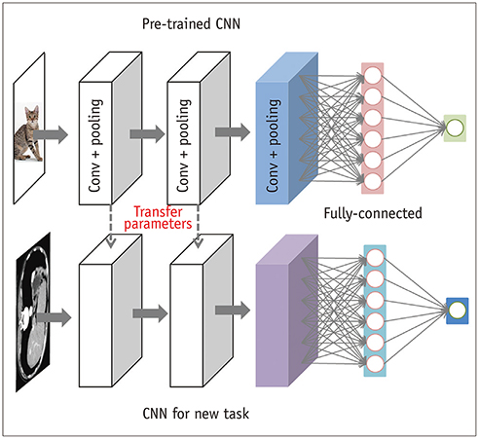
Additional Training Tricks for CNNs: Transfer Learning
We can often take pretrained CNNs and reuse the weights in new CNNs, just retraining the last few layers for the new task. The pretrained model that gets reused is called the ”backbone”.
Works because the “learning” in the early stages of the CNN is often relevant for many tasks, e.g., finding edges.
Allows use of large CNNs trained on large datasets in new problems. E.g., one can use VGG trained on ImageNet (14x10⁶ images, 22x10⁴ categories) as a backbone in a problem with just a few hundred materials images. Can dramatically increase accuracy and decreases training time of new models!
Figure credit: S. Do, et al., Korean J. of Radiology (2020)

Slide 63
Outline
What are deep neural networks (NNs)?
Training and predicting with deep NNs
Convolution Neural Networks (CNNs)
Image Classification with CNNs
Object Detection with CNNs
Materials Applications and Lab Introduction

Slide 64
Basic Problems in Computer Vision
Classification + Localization
(Semantic/Instance) Segmentation
Classification
Object Detection
Figure credit: https://medium.com/comet-app/review-of-deep-learning-algorithms-for-object-detection-c1f3d437b852

Slide 65
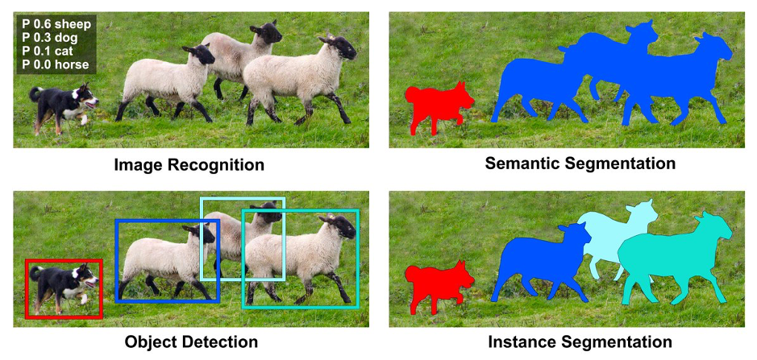
Semantic Vs. Instance Segmentation
Figure credit: https://wiki.math.uwaterloo.ca/statwiki/index.php?title=User%3AX93ma&ref=blog.roboflow.com

Slide 66
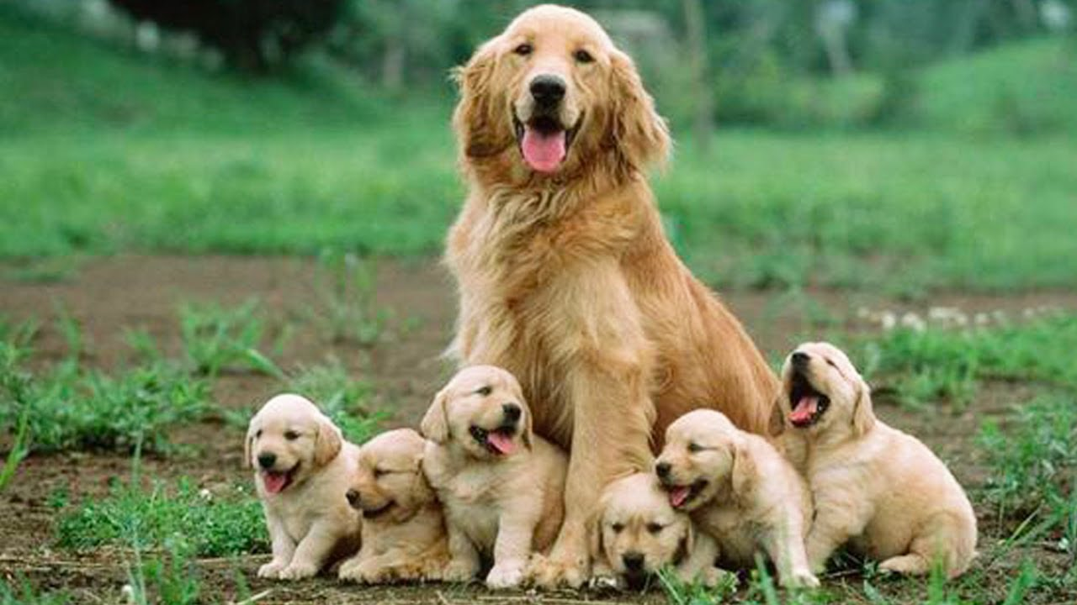



Challenges in Generating Bounding Boxes
Varying Object Size
Varying Aspect Ratio
Complex Shape and Overlap
Multiple Response
Notes:
Ben – Figure reference???

Slide 67
Two General Approaches to Object Detection
Multi-stage
Region-based CNN (RCNN)
(RCNN) – 2014, (Fast-RCNN) – 2015, (Faster-RCNN) – 2016
Single-Stage
Single Shot MultiBox Detector, You Only Look Once (YOLO)
(SSD) – 2016, (YOLO) – 2016, 2017, 2020, 2022
More accurate
More memory intensive
Less Accurate (still? I am not sure …)
Less memory intensive
Runs in real time (30+ fps)
Runs around 1-10 fps (Faster-RCNN)
Separates out region proposal and classification into separate steps
Combine proposal and classification into a single step
Notes:
There are two main strategies people have used to approach object detection, with the main difference being how much time is spent trying to accurately generate the bounding boxes

Slide 68

YOLO Approach to Bounding Boxes
Redmon, J., Divvala, S., Girshick, R., & Farhadi, A. (n.d.). You Only Look Once: Unified, Real-Time Object Detection. Retrieved March 23, 2023, from http://pjreddie.com/yolo/
Useful ref to explain Yolo: https://www.v7labs.com/blog/yolo-object-detection
Notes:
Total image is gridded
Bounding boxes generated referencing the fixed grid
Confidence in each bounding box prediction is referenced to the intersection over union (IOU) of the bounding box in the training data
Classification on the grid (bottom image) then conditions the bounding box predictions to assign class
Redmon, J., Divvala, S., Girshick, R., & Farhadi, A. (n.d.). You Only Look Once: Unified, Real-Time Object Detection. Retrieved March 23, 2023, from http://pjreddie.com/yolo/

Slide 69

How Does Yolo Relate to Our Standard CNN?
Fairly standard CNN architecture (24 convolutional layers + 2 fully connected layers). Pretrain first 20 layers on large database. Fit remaining to new data.
The model predicts for each box: location, size, class probability, confidence it is right. These are compared to ground truth in an approximately mean squared distance manner to determine loss function. This shows how loss can be almost anything that gets you what you want!
Caveat: Above describes Yolo v1 from 2016 – we are on v8 now and spirit is similar but many changes
Images and Ideas from https://towardsdatascience.com/yolo-you-only-look-once-real-time-object-detection-explained-492dc9230006 and https://jonathan-hui.medium.com/real-time-object-detection-with-yolo-yolov2-28b1b93e2088
Notes:
Define a score for each box that is (approximately) a sum of errors in how close the box is to right position, the probability the right class is in the box, and how x, y, w, h, Object detection is enabled by redefining loss function to track and optimize bounding boxes and classification. Creates (S*S)*(B*5+C) parameters and just minimizes their discrepancy with ground truth (a tweaked RMSE) (5 is from x,y,w,h,conf).

Slide 70
Basic Problems in Computer Vision
Classification + Localization
Instance Segmentation
Classification
Object Detection
Notes:
Reminder on Segmentation
https://medium.com/comet-app/review-of-deep-learning-algorithms-for-object-detection-c1f3d437b852

Slide 71

We Can Easily Add Segmentation to Object Detection
For any given bounding box with object in it create a class map like this one (likely just zeros and Ns for object in class N). This is in labeled ground truth training data.
Build a CNN or full connected NN that optimizes classification of each pixel (loss is cross-entropy from each pixel).
YOLO added 3 parallel CNNs on bounding box images to implement segmentation. It is included in v5 and v8.
Figure credit: https://www.jeremyjordan.me/semantic-segmentation/
Yolo v8 description in https://docs.ultralytics.com/tasks/segment/

Slide 72
Summary
Classification + Localization
Object Detection
(Semantic/Instance) Segmentation
Classification
Convolutional neural networks (CNNs) are a kind of deep NN that make use of local structure in images to greatly reduce the number of necessary parameters.
CNNs can be used to accurately categorize, detect objects, and segment (find all pixels in an object), particularly when using transfer learning on pretrained networks.
State of the art tools (e.g., Yolo v8) are free and available, can be implemented with a few dozen lines of codes, and can be trained for many practical problems in a matter of hours with a single GPU.

Slide 73
Outline
What are deep neural networks (NNs)?
Training and predicting with deep NNs
Convolution Neural Networks (CNNs)
Image Classification with CNNs
Object Detection with CNNs
Materials Applications and Lab Introduction

Slide 74
Applications of Deep Learning Computer Vision in Materials
Methods and analysis of metal powder particle SEM images
Classification (ResNet 50, VGG16)
Semantic Segmentation (U-Net)
Object detection (Faster R-CNN, YOLO)
Instance segmentation (Mask R-CNN)
Figure credit: Holm, E. et al., Metall. Mater. Trans. A 2020: https://doi.org/10.1007/s11661-020-06008-4

Slide 75

Applications of Deep Learning Computer Vision in Materials
Finding atoms
Finding column thickness (3D from 2D)
Analysis of high-resolution electron microscopy images
Finding defects
Figure credit: R. Jacobs, Comp. Mat. Sci. 2023 https://doi.org/10.1016/j.commatsci.2022.111527

Slide 76
Today’s Lab: Radiation Defects in Electron Microscopy
How We Can Use Machine Learning to Analyze Images Like Below
50 nm
Jacobs, R., et al. Cell Rep. Phys. Sci. 2022: https://doi.org/10.1016/j.xcrp.2022.100876

Slide 77
Laboratory to Analyze Defects from Electron Microscopy
Classification with
Fully connected NN
Convolutional NN - Hand crafted
Convolutional NN – VGG Backbone, data augmentation.
Object detection with YOLO
Jacobs, R., et al. Cell Rep. Phys. Sci. 2022: https://doi.org/10.1016/j.xcrp.2022.100876;
Shen, et al., Comp. Mat. Sci. 2021 https://doi.org/10.1016/j.commatsci.2021.110576
Lab allows you to apply and explore many of concepts from these slides, including fully connected NN, CNN, data augmentation, dropout, transfer learning, training and validation loss, classification and object detection, YOLO, …

